Slide 1
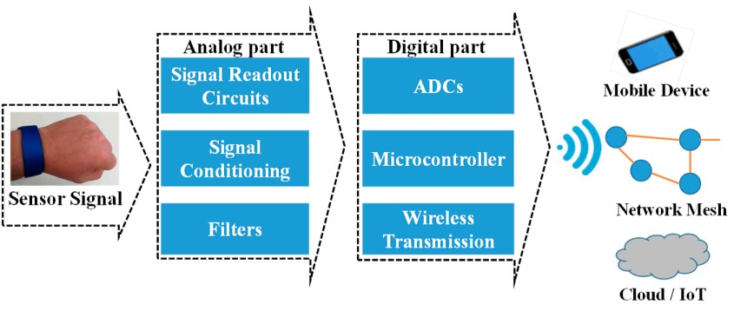
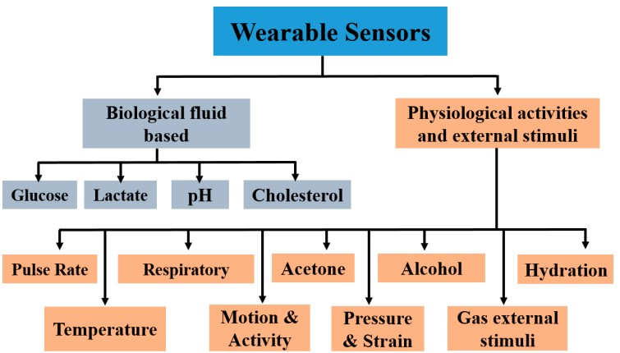
Recent Developments in Printing Flexible and Wearable Sensing Electronics for Healthcare Applications
Reference: Saleem Khan *, Shawkat Ali and Amine Bermak College of Science and Engineering, Hamad Bin Khalifa University, Qatar Foundation, Doha 5825, Qatar; shaali@hbku.edu.qa (S.A.); abermak@hbku.edu.qa (A.B.) * Correspondence: sakhan3@qf.org.qa Received: 24 January 2019; Accepted: 5 March 2019; Published: 11 March 2019
Polymeric substrates are ideal for employing these sensing devices and circuits for their properties such as their light weight, low cost, flexibility, bendability, foldability, stretchability, and conformability to uneven surfaces with negligible losses to the sensor.
Blood, saliva, tears, and sweat are the main bio-recognition sources for assessing human health conditions. Among these, sweat-based sensors are ideal for wearable applications due to the easy and non-invasive deployment onto the epidermis and the simple replacement procedure using disposable sensor patches.
The majority of developed wearable sensors are functionalized with specific enzymes to enhance the selectivity and sensitivity toward a specific analyte.

Slide 2
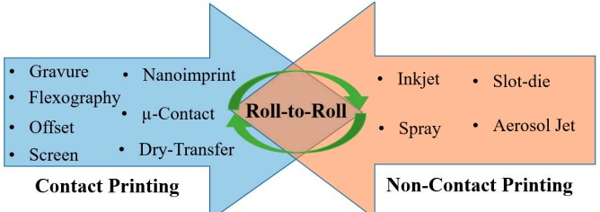
Printing techniques are broadly divided into two categories based on contact and non-contact printing .
In the contact-based approach, the printing medium with designed structures on the surface is inked and brought in physical contact with the target substrate.
In non-contact-based printing, materials are ejected in the form of micro-droplets or a continuous jet, facilitated by miniaturized printing nozzle heads. This is often referred to as digital manufacturing, where droplets/jets are ejected on demand as a result of the respective actuation mechanism. Non-contact approaches are more attractive as they are versatile and allow rapid changes in the designed structures using computer-controlled software.
Roll-to-roll (R2R) manufacturing is the ultimate goal of developing such printing technologies. R2R serves as a common platform by installing different printing and in-line curing/sintering systems for the batch manufacturing of electronic components at higher speeds.
Thin polymeric sheets with minimum thicknesses are ideal for wearable applications. Polymeric materials, such as polyimide (PI), polyurethane (PU), polyethylene terephthalate (PET), polyethylene naphthalene (PEN), polydimethylsiloxane (PDMS), etc., are some of the representative substrates that are vastly used. Their chemical inertness, as well as their thermal and electrical insulation, makes these polymeric substrates ideal for sensor and electronic development . Biocompatibility is one of the major requirements for on-body integrated or epidermal sensors and substrates, with PDMS-, PU-, polylactic acid (PLA)-, and cellulose-based polymer substrates being explored recently. Additionally, some other non-conventional substrates based on textiles are also used for wearable electronic applications .

Slide 3
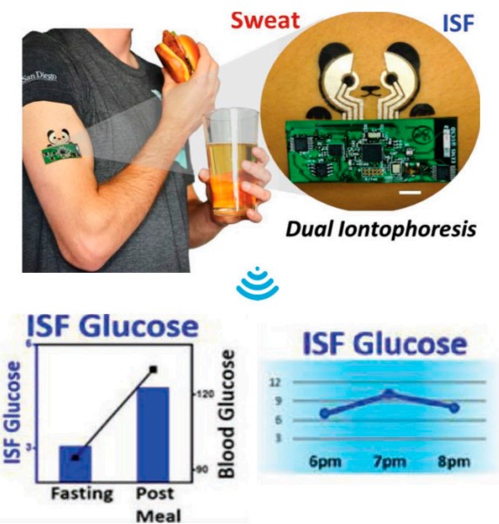
Different human physiological fluids such as blood, urine, sweat, saliva, interstitial fluid, ocular fluid, and breath contain glucose biomarkers for the detection for diabetes .
The most prominent approach for selective detection is through enzymatic methods, i.e., glucose oxidase (GOx), whereby redox reactions occur at the interfacing medium.
The sensor measures the decrease in oxygen concentration and the liberation of hydrogen peroxide (H2O2), which is directly proportional to glucose concentration
A non-enzymatic robust wearable sensor patch with all the complementary signal processing and communication tools was proposed on flexible stainless steel.
Sensors were implanted into sub-cutaneous tissue, and they continuously measured the interstitial fluid glucose at various intervals.
Organic material-based biosensors are interesting for wearables, as they comply with the basic requirements of processing at ambient temperature, as well as biocompatibility.
A PEDOT(poly(3,4-ethylenedioxythiophene))–glucose oxidase cross-linked biosensor was used for amperometric-based(based on current) sensing. A three-electrode structure was developed on PET substrate with front-end electronics for the remote monitoring of glucose levels.

Slide 4
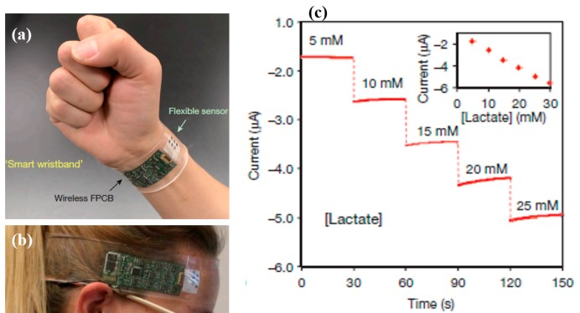
Lactate is one of the key metabolites in the human body which is produced in muscles due to the anaerobic metabolism of glucose.
Continuous monitoring of lactate is essential during exercise, particularly for athletes, to avoid cell acidosis, which results in disruption of muscular performance.
Different fluids in the human body contain a certain level of lactate concentration. However, the level is different in other body fluids such as tears, saliva, sweat, etc. Monitoring through wearable sensors is required to be non-invasive, ideally through the analysis of sweat or interstitial body fluids .
An electrochemical tattoo-based biosensor was developed through printing .
The sensor was developed using Ag/AgCl and functionalized MWCTs (multi-wall carbon nanotubes) in a three-electrode architecture.

Slide 5
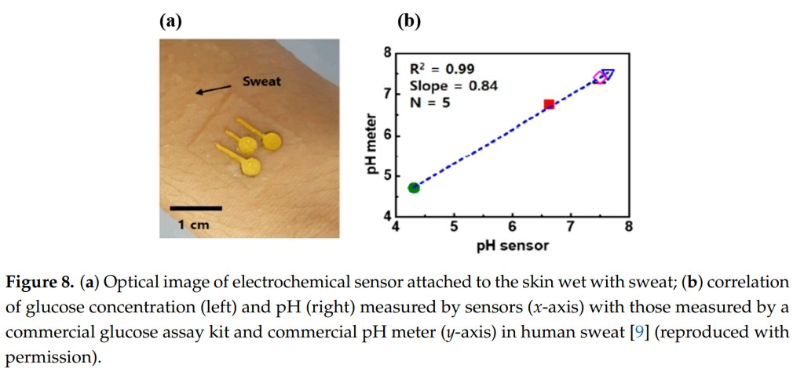
The pH is the measure of acidity and alkalinity, measuring pH is critical and fundamental to various environmental, biological, and chemical processes.
For instance, potentiometric, chemiresistive(detection of methane) , optical, mass, and capacitive techniques, among others, were conventionally applied to measure the pH levels of corresponding solutions
Conventionally, pH measurement is performed using glass electrodes and ion-selective field-effect transistors (ISFET). The rigidity, requirement of a reference electrode, and the risk of leakage of electrolyte make it more challenging for miniaturization and wearability of the sensors on uneven surfaces.
Therefore, new strategies, such as chemiresistive sensing, were considered as the most suitable approach toward lowcost and miniaturized devices, allowing wearability with a minimal effect on the responses.
The pH of patients with type II diabetes and having kidney stones is lower than that of normal human beings. Similarly, several issues related to skin disorders are also dependent on pH values

Slide 6
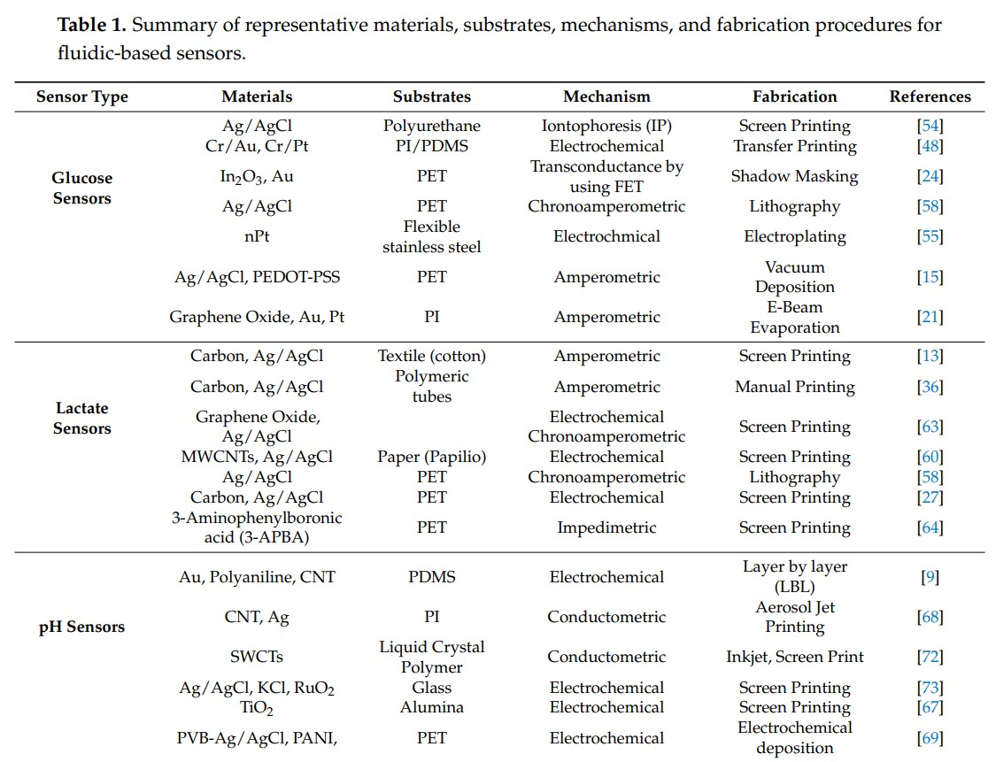

Slide 7
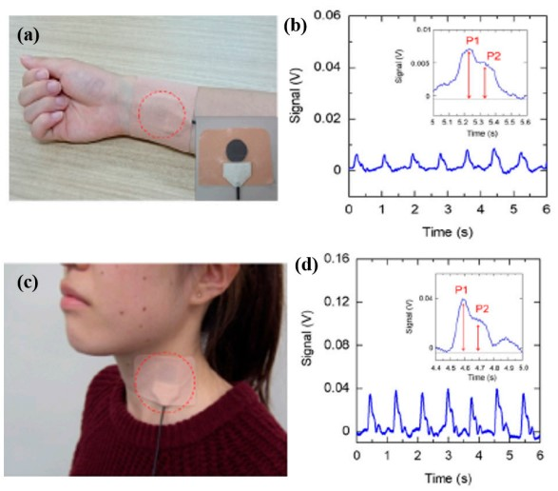
Measuring pulse rate is an interesting biomarker toward real-time human health monitoring.
For instance, the difference in the intensity of transmitted and received light from a small light-emitting diode (LED) passing through a part of the human body (especially the finger or earlobe) is conventionally practiced.
In another approach, pulse rate is measured using highly sensitive pressure sensors mounted on the blood vessels on top of the human skin.
The LED-based sensing technique matured and can be implemented as standalone or as an integral part of electronic gadgets such as smart watches and wristbands.

Slide 8
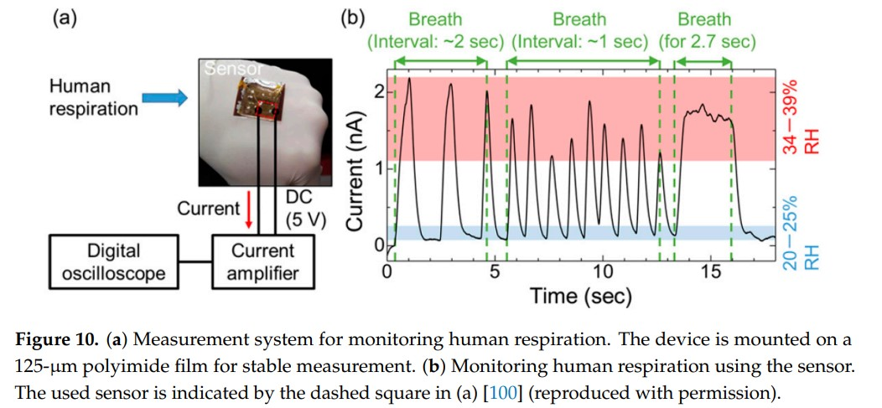
The respiration rate changes as a result of different diseases such as asthma, chronic obstructive pulmonary disease (COPD), chronic bronchitis, pneumonia, nasal and sinus blockage, cough, mild fever, etc.
Therefore, continuous monitoring of the respiratory rate is of prime importance for the early detection and diagnosis of any occurring irregularities.
For instance, highly precise and ultrasensitive temperature sensors were used to detect nasal activity during breathing . The slight change in temperature due to inhaling and exhaling is considered as a reference for the breathing rate.
Polymer-based (PVDF) nasal sensors were also used to exploit the piezoelectric properties upon bending. Such systems are bulky, interruptive, and unfriendly, especially in the case of elderly people.
The chest expansion and contraction upon inhaling and exhaling, respectively, can easily be monitored using strain sensors.
An all-painted respiration sensor was produced recently using a film of silica nanoparticles combined with a sensitive graphite layer. The sensors were produced on a flexible substrate to enable conformal integration onto a non-planar surface of human body.
Graphene-oxide-based sensors were produced in another interesting development, as shown in Figure 10, where the sensor was embedded in a wearable mask equipped with radio-frequency identification (RFID) for continuous breath monitoring . Functionalizing graphene can extend the sensing properties, and the sensors can be used for the selective detection of analytes with enhanced performance.
Here, the sensor was mounted onto the wrist to monitor the pulse and respiration rate. Respiration monitoring during sleep is also essential, as obstructive sleep apnea is one of the most common sleep disorders. The printed sensor, placed on the human body, is capable of detecting breathing movements by measuring the change in magnetic vectors.

Slide 9
Cholesterol monitoring is vital for human health to have better control over increasing risks to the human body.
For instance, an increased level of cholesterol in blood may lead to heart diseases, stroke, high blood pressure, coronary artery diseases, arteriosclerosis, cerebral thrombosis, etc.
OECT (organic electrochemical transistor)-based sensors are developed for cholesterol monitoring. PEDOT–PSS (polystyrene sulfonate) was incorporated as the channel material in OECT, while functionalizing the gate electrode with cholesterol oxidase and the biocompatible polymer Nafion, to enhance the sensors selectivity toward cholesterol detection.
An array of integrated field-effect transistors (i-FETs) was reported for the simultaneous and selective detection of cholesterol, glucose, and urea using multiple analytes.
ZnO nanorods were used for making arrays of biosensors highly reliable for the rapid detection of multiple analytes. Very few researches explored the production of sensing devices on polymeric substrates through printing technologies.

Slide 10
Acetone is a particular biomarker, found alongside many other VOCs( volatile organic compounds ) in human exhaled breath. A high level of ketones (acetone) is produced as a result of burning fats in the human body caused by insufficient insulin production to break down glucose.
The produced acetone is expelled from the human body through the lungs via breathing and partly in urine through diffusion. Conventionally, gas chromatography coupled with mass spectrometry (GC–MS) is used to determine the trace levels of VOCs in human breath; however, portable systems are desired for wearable, real-time, and continuous monitoring.
The latest developments in nanoscale materials, especially the thin films of metal-oxide semiconductors (MOX), resulted in the development of miniaturized sensors that are more suitable for handheld monitoring systems.
The higher surface-to-volume ratio of nanomaterials and the porosity in the thin films were reported to be sensitive to minute trace levels (i.e., parts per billion (ppb)) of the gas analytes. Representative MOX(Metal oxide) semiconductor materials such as SnO2 (tin oxide), ZnO (zinc oxide), WO3 (tungsten oxide), CuO (copper oxide) nanowires, In2O3 (indium oxide), Fe2O3 (ferrous oxide), etc. were used for sensing various gases in human breath.
Selectivity toward acetone can be enhanced via the functionalization of MWCNTs with acidic solutions, such as 16-mercaptohexadecanoic acid (MHDA), etc. Most recent sensors based on MWCNTs were developed on polymeric substrates, which requires heterogeneous integration onto wearable modules to enable the sensors for continuous monitoring.

Slide 11
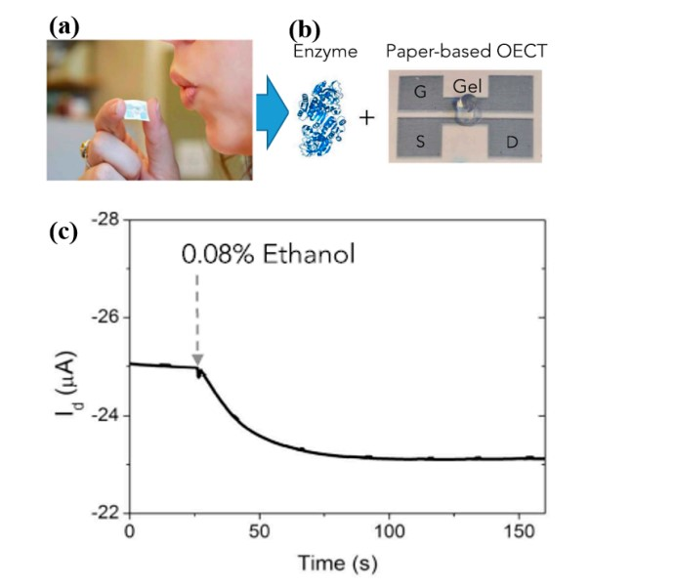
Measuring alcohol levels in human breath is a well-known technique practiced to monitor drivers alertness.
The conventional procedure for such analysis is to use breathalyzers for the estimation of blood alcohol content (BAC) from the concentration of ethanol in the exhaled breath.
Few researches were carried out where wearable sensors were demonstrated to monitor alcohol levels in human breath or in sweat. MOX-based nanomaterials are considered to be more responsive; Zn-based sensors (i.e., ZnO and ZnTiO4) in particular were explored as wearable ethanol gas sensors.
A low-cost and disposable breathalyzer was developed using an organic electrochemical transistor (OECT) on paper substrates, as shown in Figure 11. The device was printed using an organic conductor (i.e., PEDOT–PSS), with alcohol dehydrogenase (ADH) as its cofactor, functionalized in a gel and placed in the OECT channel for selective detection at minute levels.
In the latest development, a lancet-free approach was proposed for simultaneous monitoring of alcohol and glucose in human sweat. Sensors were developed by integrating ZnO thin films in a nanoporous flexible electrode system.

Slide 12
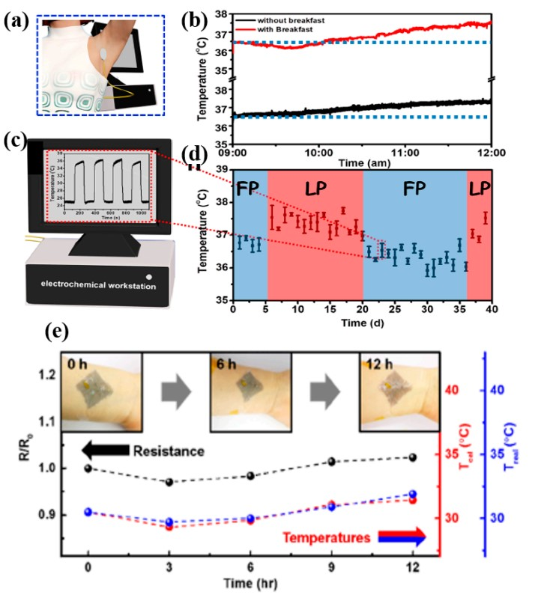
A large variety of thermal sensors were developed using intrinsic conducting and nanocomposite materials to enable wearability at minimum bending angles. One such sensing device was developed using a polymeric blend with SWCNTs(single-wall carbon nanotubes) for the simultaneous detection of temperature and CO2 gas.
The mounting of sensors directly onto the epidermis requires substrates with properties similar to the human skin, such as biocompatibility, air/oxygen permeability, being waterproof, etc.
One such development was reported, presenting breathable and stretchable temperature sensor. Sensors were also developed via the transfer printing of Cu strips onto semipermeable polyurethane films.
Skin-mounted biosensors for the simultaneous detection of sweat metabolites, electrolytes, and temperature were developed in a single patch for prolonged wearability during exercise.
Another similar approach to the simultaneous monitoring of sweat pH and skin temperature was proposed by measuring through an ion-selective field-effect transistor (ISFET) and an integrated temperature sensor, respectively. Ag was printed for the interconnection electrodes, while PEDOT–PSS was printed for the temperature-sensing layer.

Slide 13
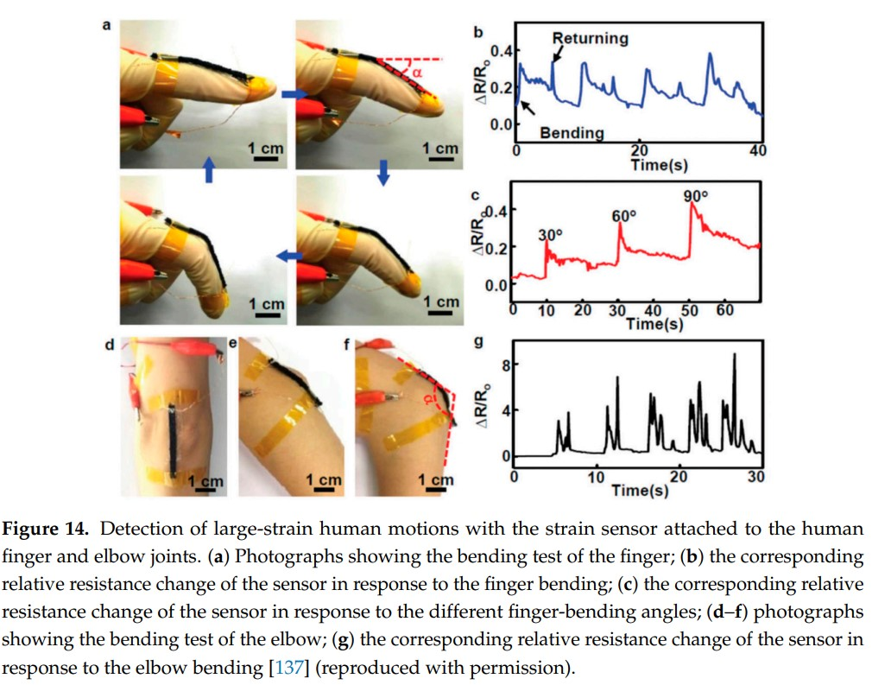
Motion detection is of particular interest for prosthetic limbs, soft robots, and physically impaired or elderly persons requiring continuous activity monitoring remotely.
State-of-the-art sensors and systems come with major hindrances such as bulkiness, rigidness, non-wearability, heavy weight, etc. The wearable suits are sometimes termed electronic skins, equipped with a few sensors to replicate the sensing capabilities of human skin.
Different approaches were pursued to develop these sensors, for instance, using discrete sensors at different parts of the body or through a well-connected wearable suit. The soft motion-sensing suit contains sensors suitably placed at the joints that are involved in moving back and forth, triggering the sensing device.
Human gait detection was presented, whereby strain sensors were embedded in a wearable suit to monitor the motion activities. Strain sensors were developed using liquid metal embedded into an elastomer and placed onto the hip, knee, and ankle joints to monitor their bending angles.

Slide 14
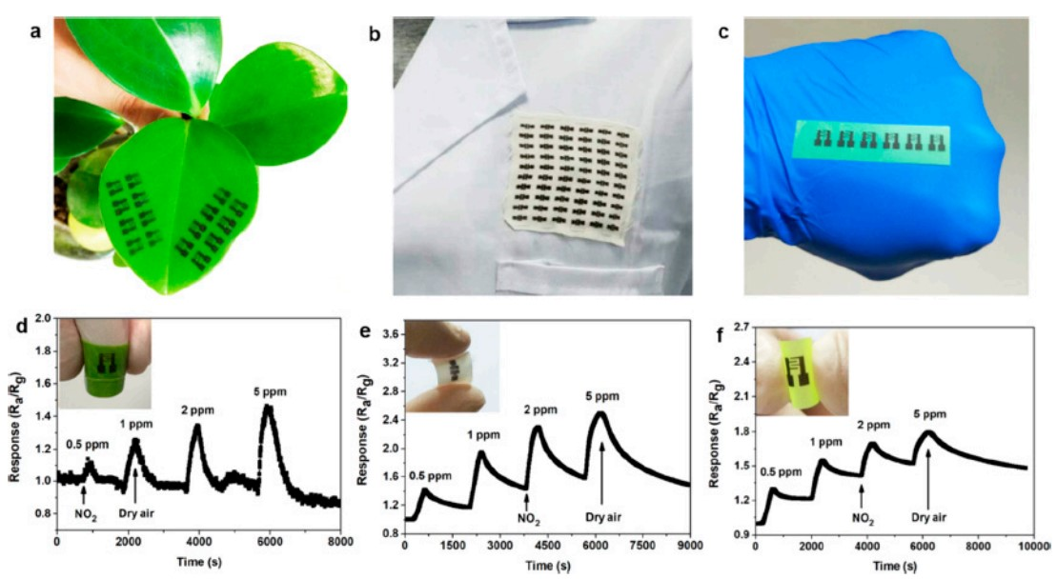
Gas sensors witnessed tremendous research interest in the latest advancements in nanoscale materials. The solution processability of a wide range of nanomaterials and their integration into polymeric substrates enabled the development of flexible gas sensors.
Gas sensors are categorized into different types; however, the detection of toxic gases in the surrounding environment and the monitoring of exhaled gases in human breath are of particular interest. In this scenario, toxic gas sensors are ideally deployed onto wearable gadgets placed at any position on the human body exposed to the outside atmosphere for gas detection. In the second case, the sensing gadget is required to be directly in the pathway of exhaled breath to detect the target gas analyte.

Slide 15
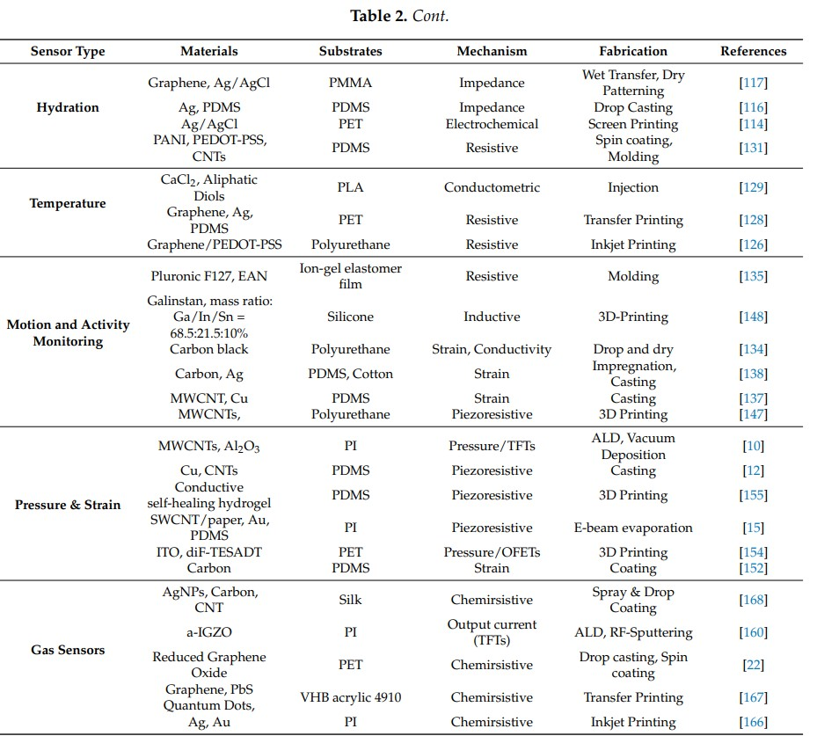

Slide 16
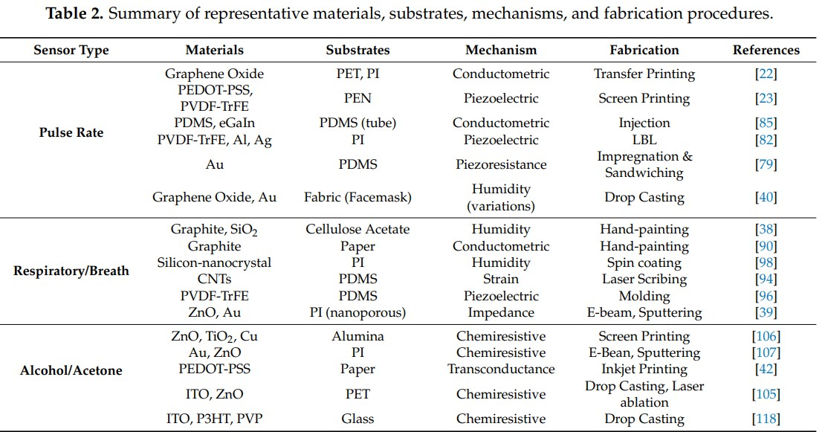

Slide 17
Not all beverages are equally beneficial after exercise. The coach must decide what drink to offer volleyball players during a game or practice.

